Slide 1
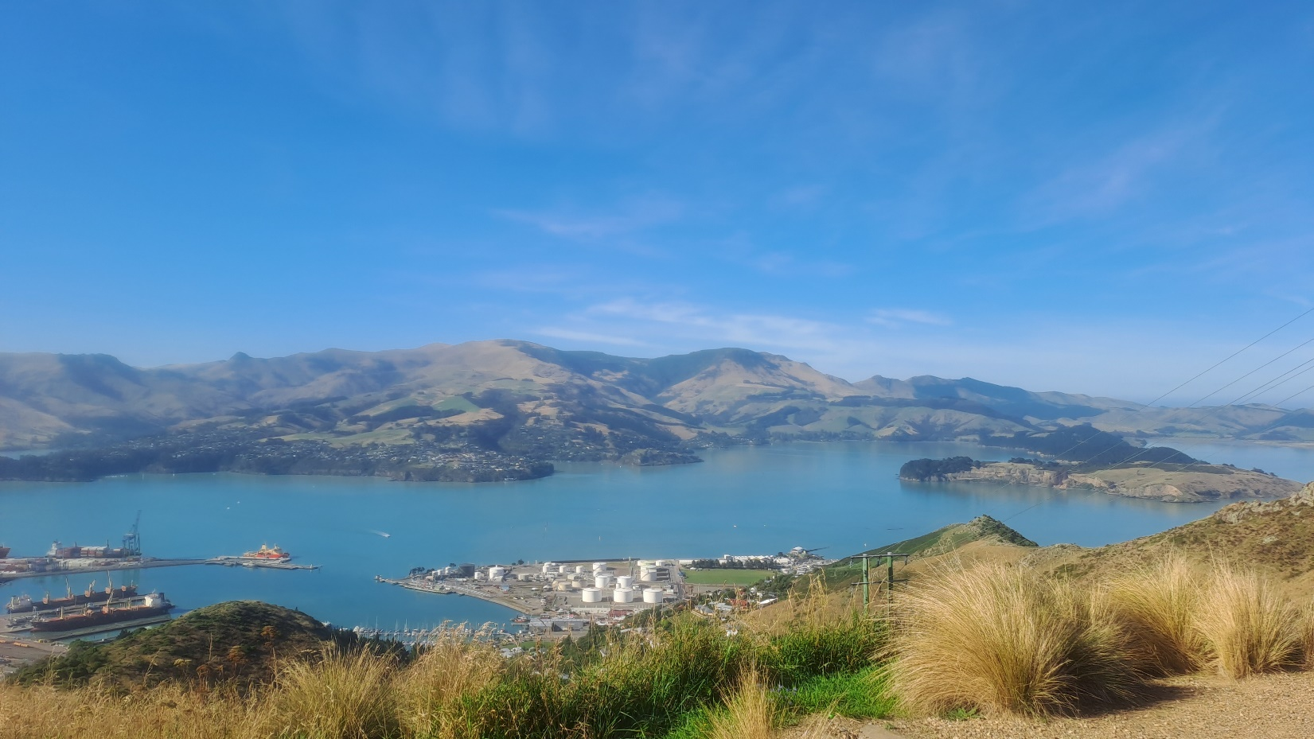
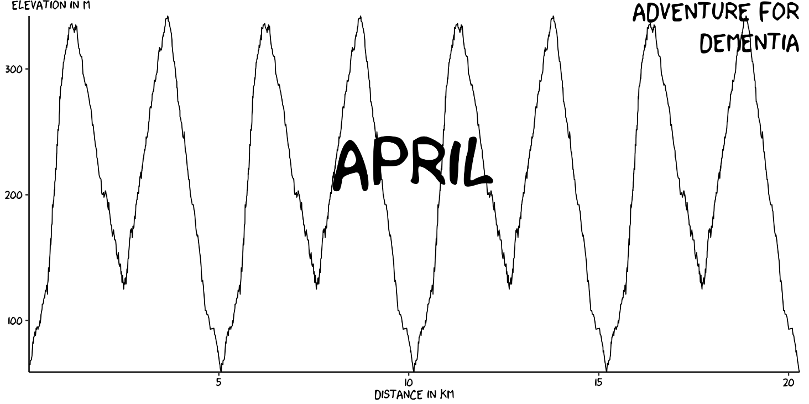

Slide 2
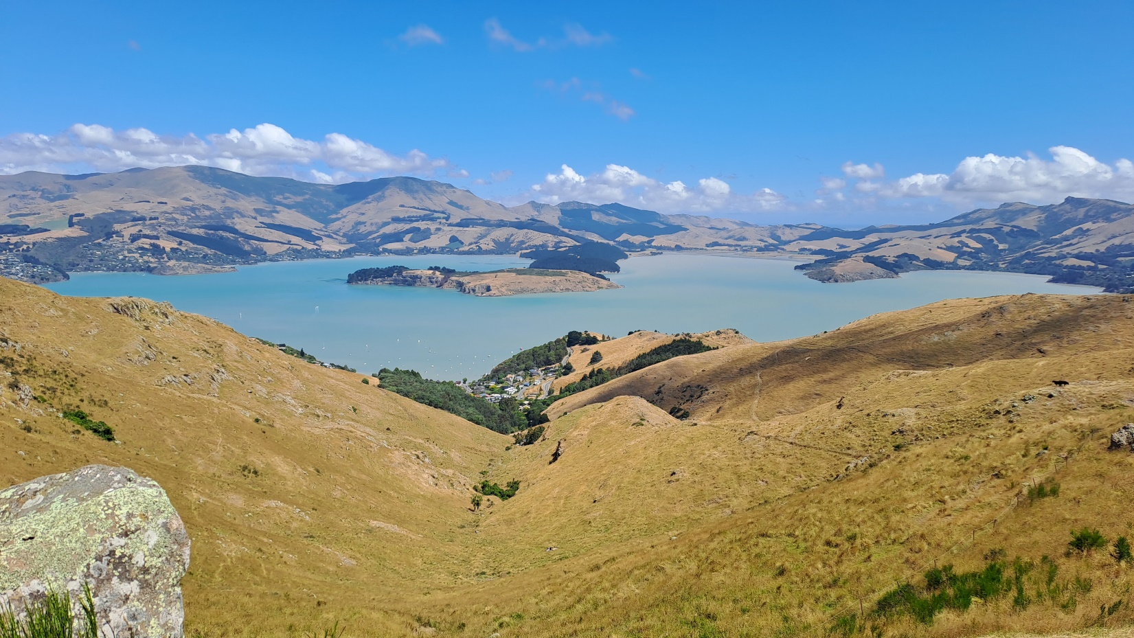
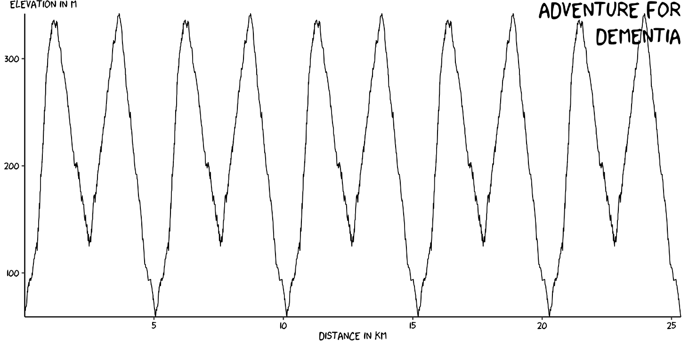
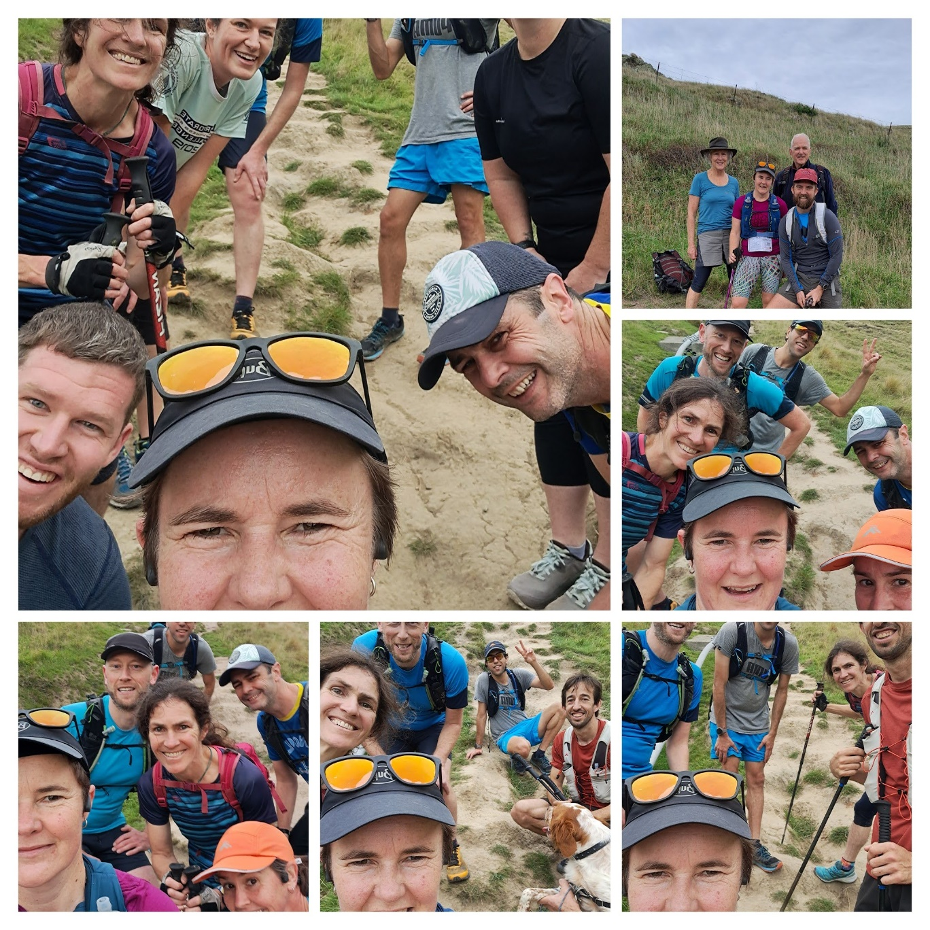
May
25 km & 2400 m
25 km & 2400 m
May
Lap 2
Lap 3
Lap 1
Lap 5
Lap 4

Slide 3

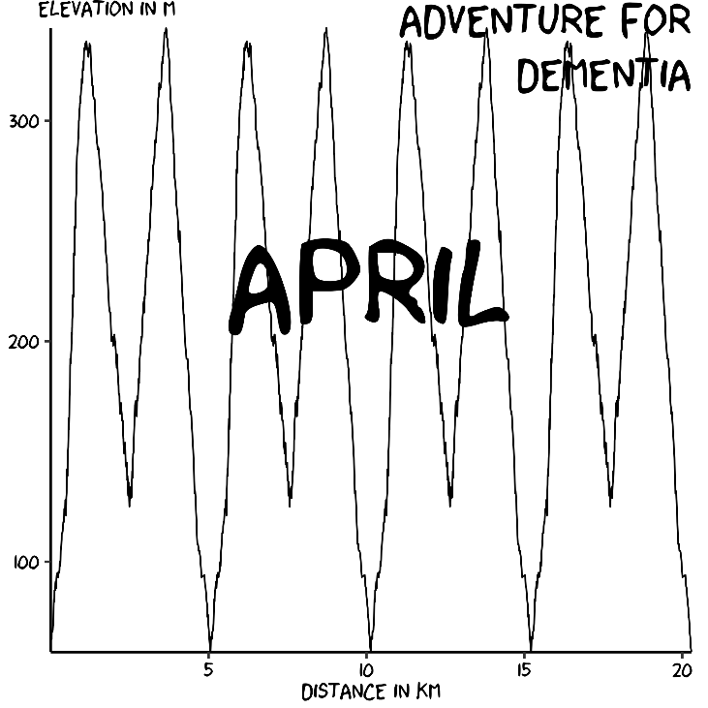

Slide 4
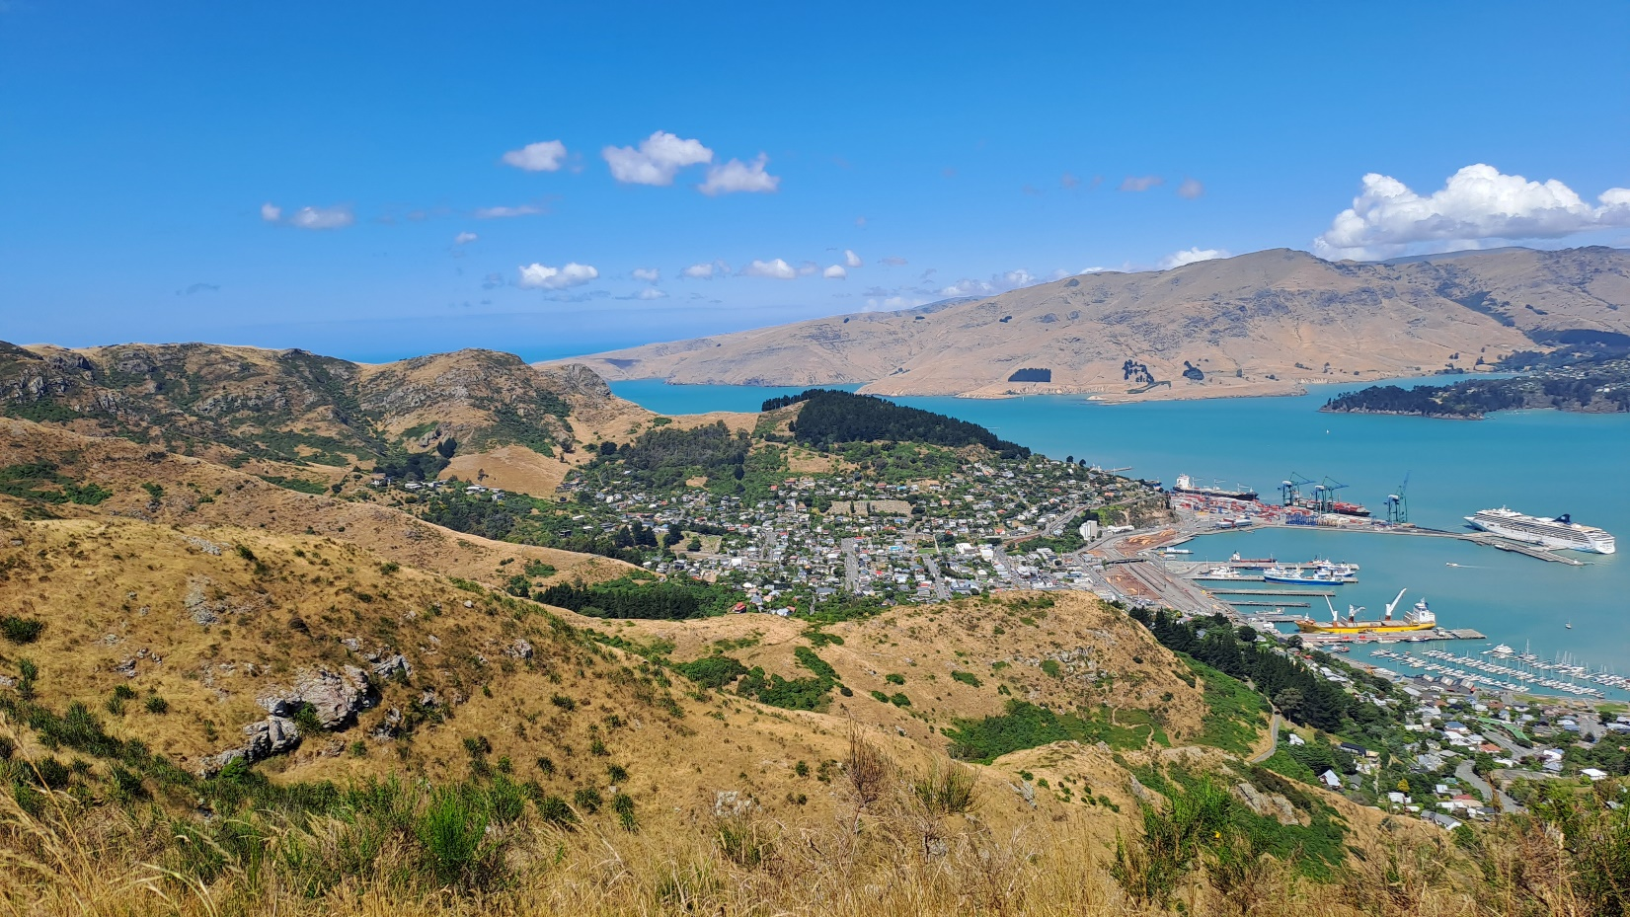
June
30 km & 2900 m
25 km & 2400 m
May
Lap 2
Lap 3
Lap 1
Lap 5
Lap 4

Slide 6
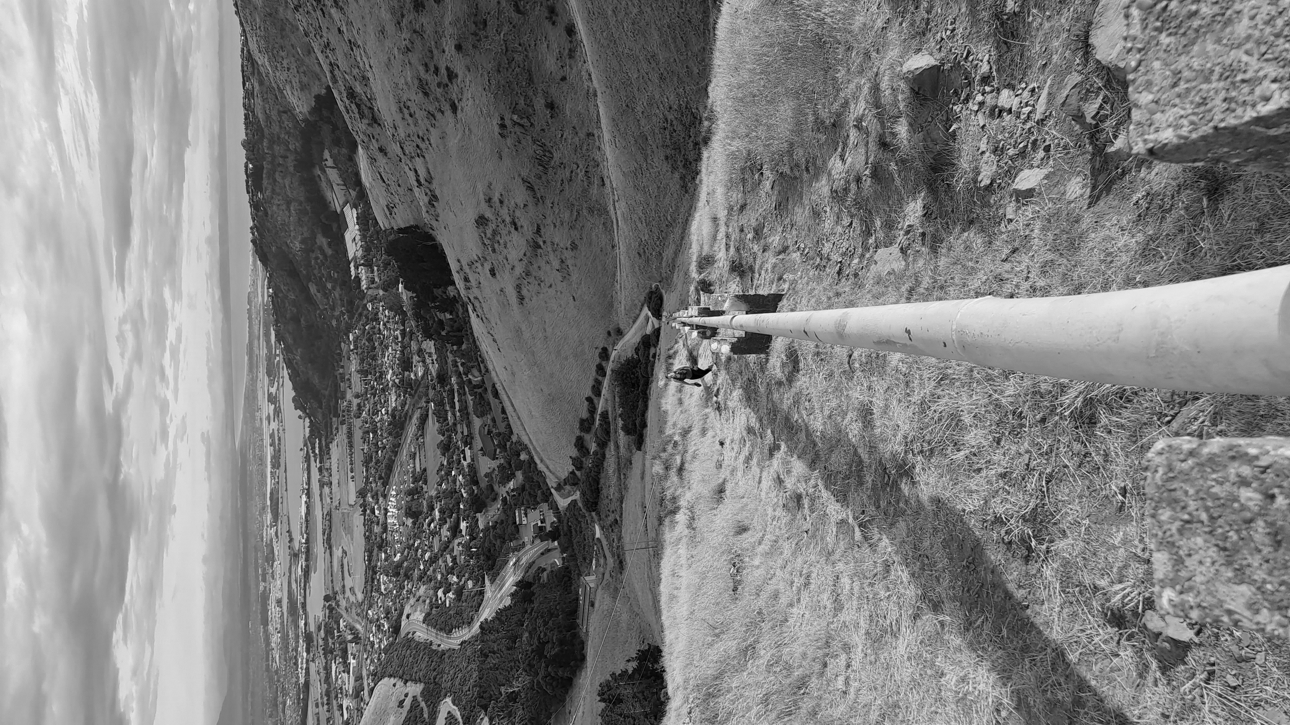
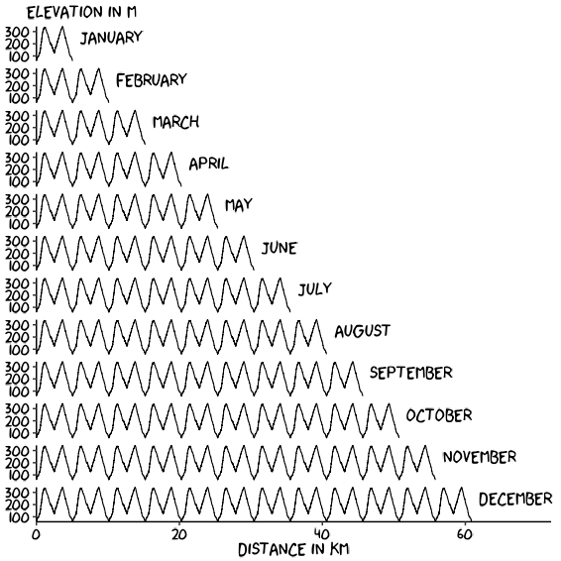


Adventure for
Dementia

Slide 7

Adventure for
Dementia
Adventure for
Dementia

